Slide 1
Student Information System
Dr : mohamed ramadan
Eng : Ibrahim Shawky

Slide 2
Team members :
Mahmoud Ahmed Abdullah
Mouhamed Ahmed Hashem Ahmed
Hazem Taha Basher
Hany Abdou Saad
Abdullah Hussien mohammed
Moaz Wahed Ramadan

Slide 3
Some Advantages :
Each student can register for 18 credit hours each term .
The student can modify the registration by adding a new subject or remove the subject before the midterm exam.
The system can print the full detail about student
The system can print a report about all student with their registration

Slide 4
S-Information System
The process of the system :
The user will be asked to enter the username and the password to can enter to the program.
The user will then get into one of the four following processes depending on it registration (registered or not ) :
1-register 2-login 3-modify courses 4-print information
The admin can do 4 processes :
1-Print a student’s information
2-Print all student’s information of specific level
3-Print all student’s information in all levels
4-update the deadline of courses .

Slide 5
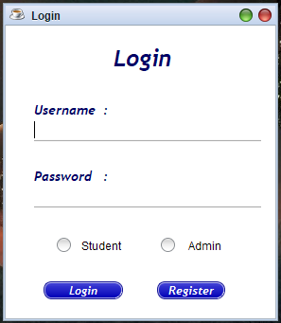
S-Information System
The login frame :
In this frame the user can login and enter to the system but that if user has a username and password already
If user don’t has username and password , user must register to can enter to the system

Slide 6
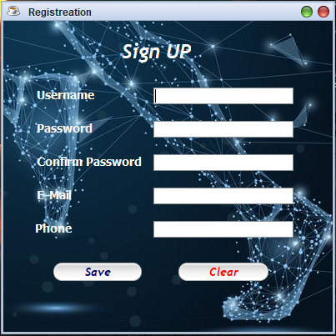
S-Information System :
The Register frame :
User will go to this form to make a registration
There is 2 buttons :
- the save button - the clean button
1-the save button : when you complete the data correctly the save button will save your data in the database of the system ; Then user can login to the system and complete his data after the login to the system
2- the clean button : if you write a wrong data the clean button will remove all the data , and the user will write it again correctly

Slide 7
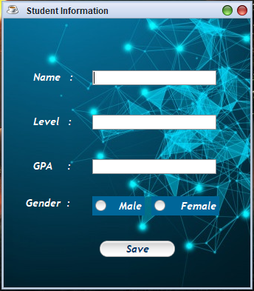
S-Information System
The register frame :
This is a frame will take from the user the personal data as name , level , GPA and the gender
After finishing this frame you will be completed the registration , and you now are in system
After you press the save button : your data will be saves in the database of the system

Slide 8
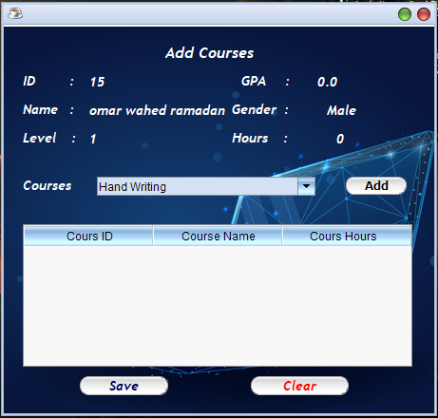
S-Information System
The modify courses frame :
From this frame the student can choose the courses which he want to learn in this term .
This form has 2 buttons :
1- the save button 2- the clear button
The clear button : is you press this button all the courses which you choose will be removed ; and you will choose the courses again .
The save button : will save your data in the database of the system .
After that you will be finished the registration ; and you will enter the system .

Slide 9
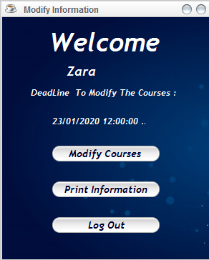
S-Information System
The system frame :
The Deadline : is the last date which the student can modify the courses to it , that is before the midterm exam
This frame has 3 buttons :
1-modify courses 2-print information 3-log out
1-modify courses : this button will make you modify the courses if you want to change it ; but it if the deadline is run only
2-print information : this button will show to the student all his information
3-log out : this will close the system and back to the main frame ( login frame ) again .

Slide 10
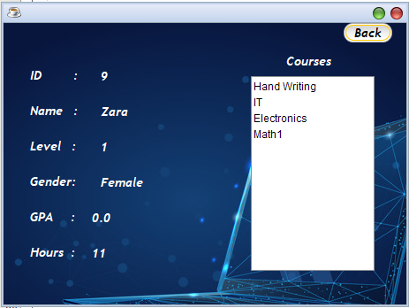
S-Information System
The print information frame

Slide 11
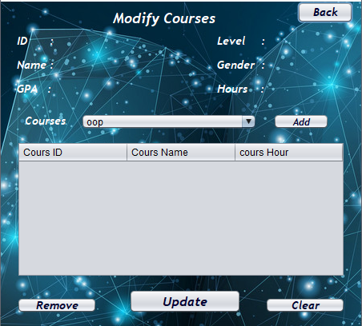
S-Information System
This frame has 4 buttons :
1-back : it will return to the main frame(of the student) .
2-remove : it will remove the course which you select from the table (but the student can choose that course again ) .
3- clear : it will remove all the courses in the table .
4 – Update : it will save the changes in the database of the system .
The modify courses frame

Slide 12
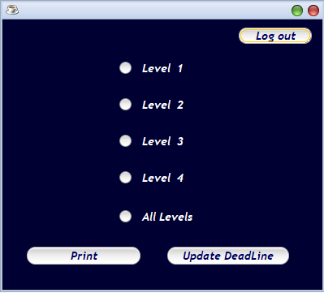
S-Information System
The admin frame :
This is the admin frame : it has 3 buttons
1-print 2-update Deadline 3-log out
1-print : will show to the admin the data which he selected
2- update Deadline : will make the admin to change the deadline
3- log out : will close this frame and back to the login frame

Slide 13
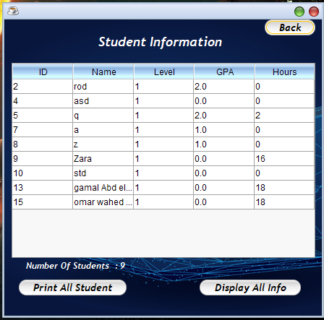
S-Information System
This is the print frame : it has 3 buttons :
1- Back : it will go to the admin frame
2- Print all student information : it will print this report of students.
3- Display All Info : will display to the admin all the information about student that he selected

Slide 14
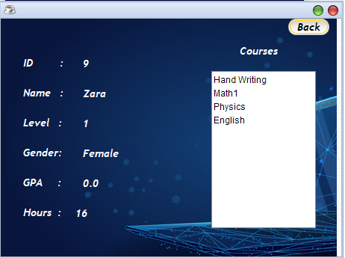
S-Information System
This frame has all information of the student , and it has a button :
1- back : this button is close this frame and return to the print frame (of the admin) .
Display All Info frame

Slide 15
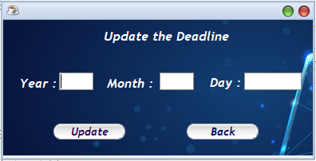
S-Information System
This is the deadline frame : from it the admin can change the deadline ; it has 2 buttons :
1-Update 2-back
1- Update : it will save the date in the database
2- back : it will return to the admin frame
The deadline frame

Slide 16
S-Information System
Program test
RUN

Slide 17

S-Information System
THANKS

